Slide 1
Project entity topics
What is the project entity?
What are the different project implementation types?
What are the different project set-ups?
What is different between project set-ups?
What are the key considerations for the project entity?
Is the project status box automatically updated?
What must be added under the project entity tabs & log?
How does allocation of funds to projects work in ProMIS?
How does the Finance tab look like?
What is the budget sub-tab?
How to edit a budget or forecast?

Slide 2
What is the expenditure sub-tab?
How does the expenditure sub-tab work?
How to enter actuals in the expenditure form?
How to edit a published expenditure entry?
What is the transfers sub-tab?
What is the transactions sub-tab?
What is the Logframe tab?

Slide 3
What is the project entity?
Project page enables users to manage project activities and progress, and to monitor the project
The project entity also includes a space for all the project documentation enabling team to jointly develop and access documents
The project entity information varies according to the project implementation type and project set-up:
Project implementation type | Project set-up
Project implementation type refers to the governance structure of the project. | Project set-up refers to the process outlined in the CBM QPRGs.
Partner implementing Own-implementation Consortia | Development project cycle Sudden onset project cycle Own-implementation project cycle

Slide 4
What are the different project implementation types?
"Partner implementing projects" are implemented by CBM partners. This project implementation type is the most common in our work.
"Own implementation projects" covers the management of grants on behalf of a partner within an approved partner project, the delivery of services or implementation of project components by CBM.
"Consortia projects" refers to LCDF project set-ups CBM is not the direct counterpart of the donor where another organisation has a contract with the them. CBM partners with this organisation.

Slide 5
What are the different project set-ups?
Three project set-ups are available:
Standard development projects: Free Funds and LCDF, representing majority of CBM supported projects. LCDF Humanitarian and Transitional Development Aid or Nexus Projects following CBM and Donor requirements should not be created with the Sudden Onset set-up but instead should be created with Standard development projects set-up.
Sudden onset projects: Humanitarian emergency projects requiring flexibility and efficiency. Sudden Onset disasters/Acute Humanitarian Crises as outlined in QPRG for Humanitarian Aid.
Own implementation: No partner, project is directly implemented by a CBM entity i.e. CO, RHO, Initiative. Guidance is provided in the own implementation Guidance note.

Slide 6
What is different between project set-ups?
The project cycles support the different project set-ups. They all have the same phases but some of the information required is different to cater for needs. For example;
Sudden Onset cycle allow for more flexibility in the order of steps, or skipping steps that are not applicable. For example:
The implementation and monitoring phase has reduced number of steps to allow for needed high degree of flexibility and efficiency.
Due to extensively varying Sudden Onset Projects implementation periods and reporting frequencies, the project cycle tasks status can be set as "Not applicable" where needed or more tasks can always be added via Tasks tab (new button).
Own Implementation cycle reflects the requirements for such projects. For example:
Does not require contracting or allocation as there is no partner involved who will receive funds.
Financial monitoring and reporting steps are not included in the implementation and monitoring phase, as this will be done in Business Central; the one financial step to be completed in the phase only acts as a confirmation that the required financial obligations have been fulfilled.

Slide 7
What are the key considerations for the project entity? (1)
A project starts with the approval of the project idea
A project is only approved after the Final Programmatic approval task in the project cycle has been completed
The Project cycle is automatically set up based on the selected option in the idea form. The cycle cannot be changed after the project page is created.
Project pages can also be created by an admin or key user with permissions.
When an admin or key user creates a project, always enter your own name first as the responsible person. Changes can be made at a later stage.
Project cycle structure CBM's project management and help align all involved 3WW stakeholders.

Slide 8
What are the key considerations for the project entity? (2)
Additionally required steps (tasks) can be added via the Tasks tab of the project and pushed to the Project Cycle.
The Implementation and monitoring phase is the only phase that will be repeated annually as the tasks occur either on a quarterly, bi-annual or annual basis.
Reviews can be contextually added to any step if needed, by the responsible members (“Add review” function is available).
Exemptions to fulfil all steps are permissible for LCDF projects where applicable. The task status can be entered as "Not Applicable" if not required by the donor.

Slide 9
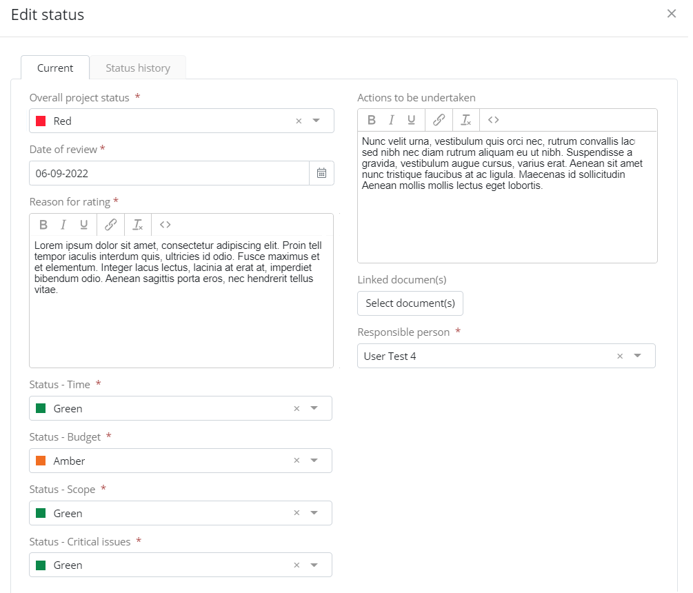
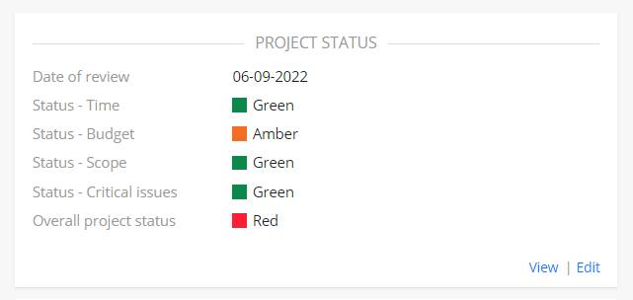
Is the project status box automatically updated?
The project status box in the overview tab of the project needs to be updated manually.
The ‘Status history’ sub-tab tracks changes to key fields over time
The ‘Overall project status’ rating entered on the Project rolls-up to the ‘Projects in this Programme’ box on any associated Programmes.
Guidance (Guidance portfolio management and rolling budget) can be found in the resource library folder 02 Projects and Programmes > sub-folder 20 Implementation and Monitoring

Slide 10
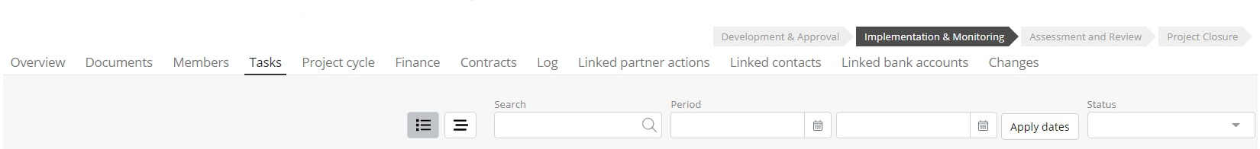
What must I add under the project task & log tab?
CBM Office feedback on/in any reports must be documented via Project page Log tab e.g. this is mandatory for Narrative reports. Log tab also to be used as a diary to capture learnings and any routine/key project implementation issues considered important by the project team.
Actions/Action Plans must be added to the Project page Tasks tab (e.g. Project Visits, Narrative reports, Mid-term evaluations etc) and key actions/tasks must be pushed to the Project cycle.

Slide 11
How does allocation of funds work in ProMIS?
Programme information
Monitoring (roll-up from Projects)
Programme
Funding pages
Institutional funds
Major donor funds
Project
Transfers to partners
Money is allocated from Funding pages directly to a Project
Free funds
Project sub-tabs and forms:
Monitoring (summary)
Incoming funding
Transfers
Expenditure
Transactions
Funding tabs:
Funding plan
Allocations
Income schedule

Slide 12
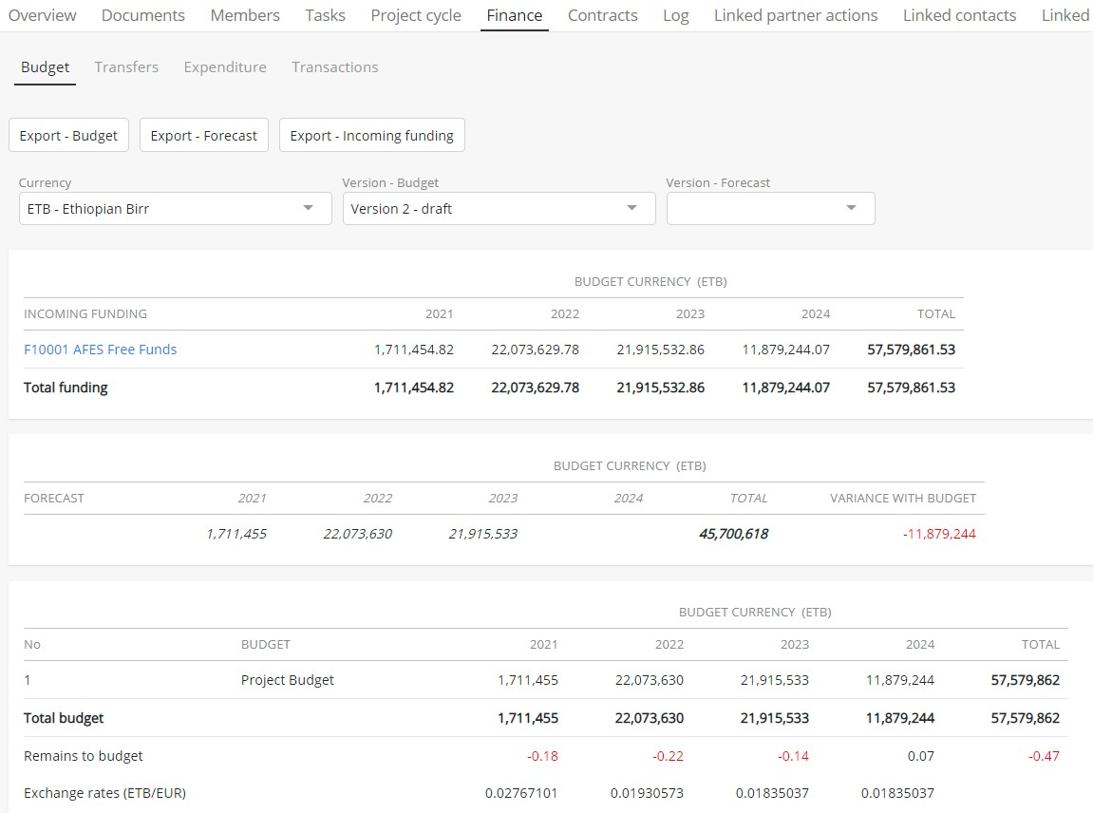
How does the Finance tab look like?
Filters: currency, forecast and budget version
Incoming funding for the Project (via allocations from Funding pages)
Project forecast
Project budget

Slide 13
What is the budget sub-tab?
The ‘Budget’ sub-tab provides a space to manage the project budget and forecast and view the total funding allocated to the Project from Funding pages (broken down by cost type, where applicable).
For the project budget, users can set up a single row total budget or add a more detailed budget (with header rows, sub-rows etc) if required by the donor. This budget required approval to publish a new version.
For the forecast budget, users can only set up a single-row forecast. This budget does not require approval to publish a new version.
Both budgets are version controlled and can be exported to excel.

Slide 14
How to edit a budget or forecast?
Entered budgets can be saved as preliminary or sent for approval. Preliminary budgets are marked as draft in the Version-Budget Dropdown menu. Approved budgets are marked with the date of the confirmation (see Version-Budget e.g. Version 1 -08-11-2022)
To create a new budget or forecast version, open the dropdown menu under “Version - Budget” and select the next possible budget version that is marked with “draft”. Then click on “edit budget” and continue with the steps mentioned above.
Enter Budgets and Forecasts in planning currency for every year of the project duration, give the entry a label name stating the period, i.e. “-2024”.

Slide 15
What is the expenditure sub-tab?
The sub-tab shows all budget rows entered in the project ‘Budget’ sub-tab (from the most recently approved version) for users to report against on a quarterly basis.
Published periods can be re-opened and overwritten if required (the system will show a warning message to confirm that the values will be overwritten).
Expenditure can only be added once a project budget is published.
Any member of the page can edit the Expenditure sub-tab. An approval is not required to publish a period.

Slide 16
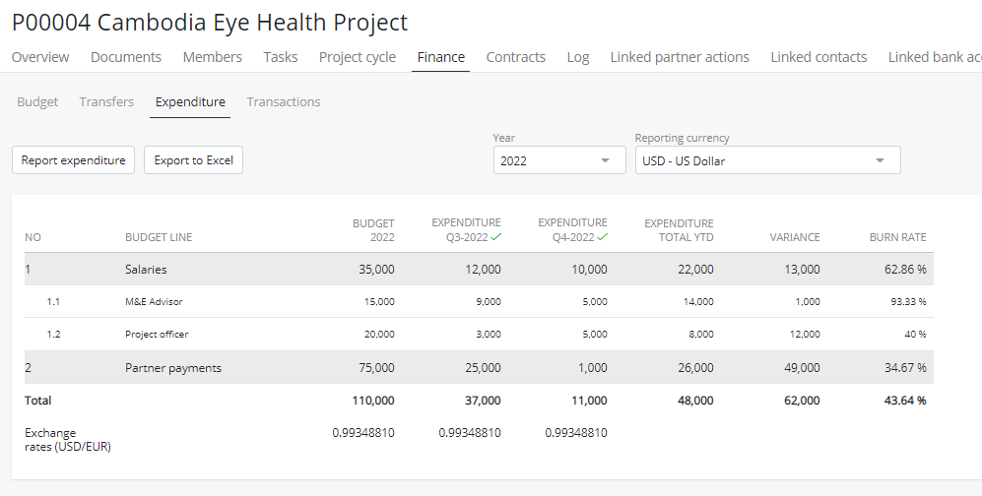
How does the expenditure sub-tab work?
Filter by year
Expenditure against the budget
The latest approved budget
The exchange rate applied

Slide 17
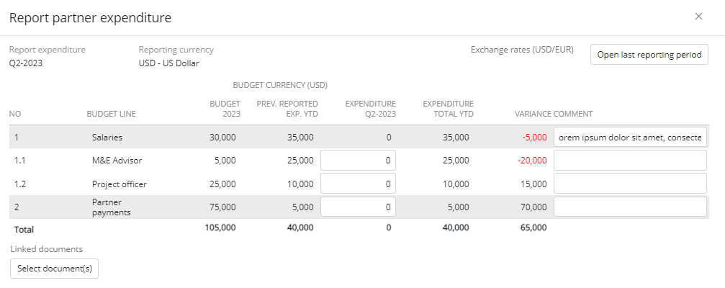
How to enter actuals in the Expenditure form?
Click on the “Reporting Expenditure” button to access the “Report partner expenditure form”:
Edit a previous reporting period
The latest approved budget
Space to input actuals/expenditure
for the period
space for brief free text explanations on any discrepancy between the budget and reported expenditure
add financial expenditure documents related to the reporting period

Slide 18
How to edit a published expenditure entry?
In the “Report partner expenditure” form, click the “Open last reporting period” button to edit any published periods as required.
Select the required reporting period via the “Report expenditure” filter box above the table, and manually edit the entries as required
After editing, click on the “Overwrite values” button. The system will show a warning message for confirmation by user if the values really need to be overwritten.

Slide 19
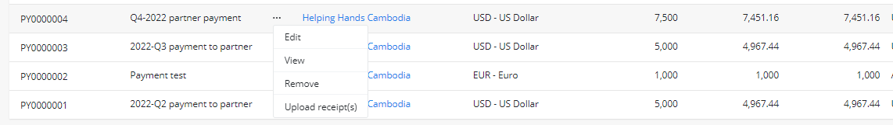
What is the transfers sub-tab?
The ‘Transfers’ sub-tab allows users to create and send payments for approval as well as upload confirmation of receipt from partners.
The Transfers sub-tab appears only when the project has reached Implementation & Monitoring phase.
The transfer is ‘pushed’ to Business Central to be processed after approval.
The payment details are ‘pulled’ back into the transfer sub-tab, after processing
Any Member of the page can create a new transfer but only certain permission groups can approve (according to the authority matrix).
The partner’s confirmation of receipt cab be uploaded via the ‘Upload receipt(s)’ option in the ellipsis menu.

Slide 20
What is the transactions sub-tab?
The ‘Transactions’ sub-tab appears only on Projects and shows a read-only view of all payments for the project processes in Business Central
Shows both transfers created within ProMIS as well as third-party payments processed directly in Business Central.
The list can be exported to excel.

Slide 21
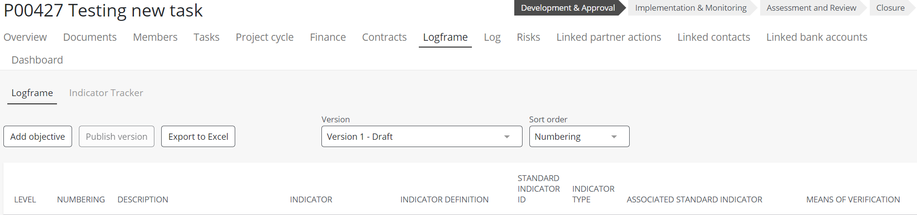
How does the logframe tab look like?
Click on „Add objective“ and add overall, specific objective or output.

Slide 22
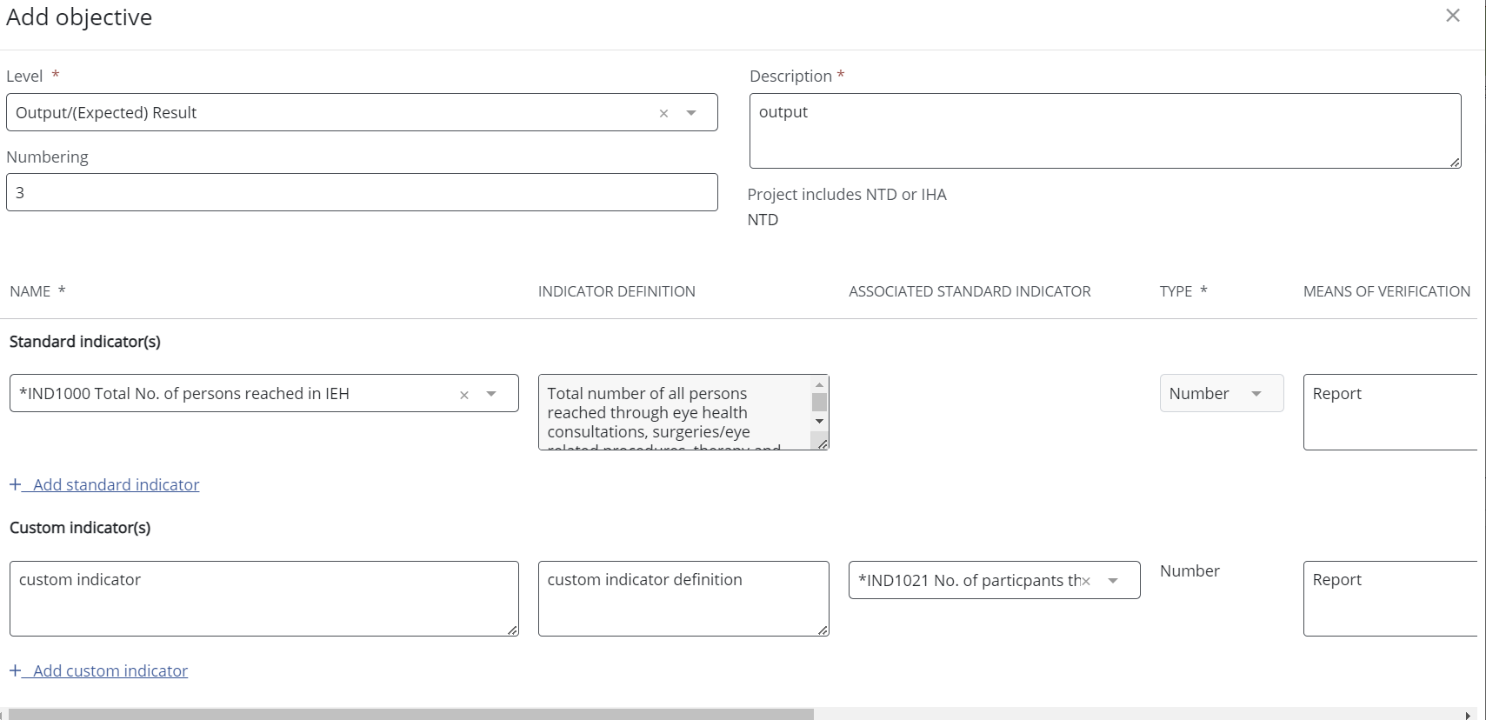










How to edit a logframe
Select the level, enter the description, select the Standard Indicator from drop-down, enter custom indicator and its definition, select Associated CBM Standard Indicator, enter the means of verifiction.

Slide 23
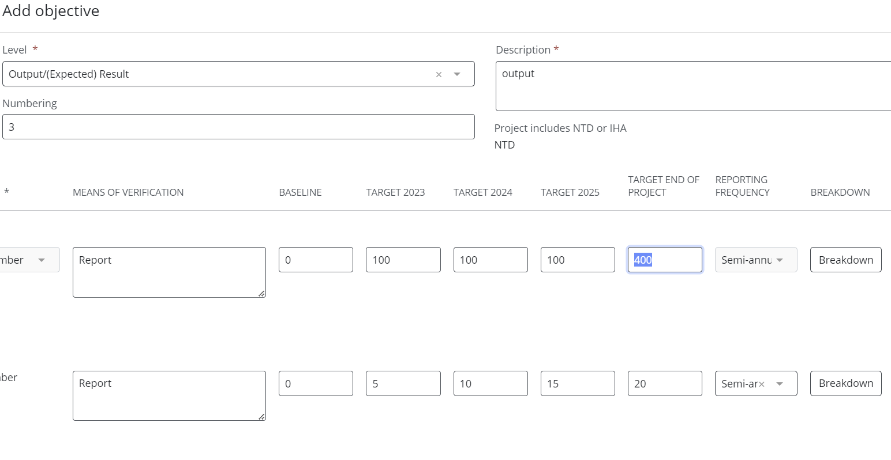






Edit logframe baseline and target values, enter breakdown values

Slide 24
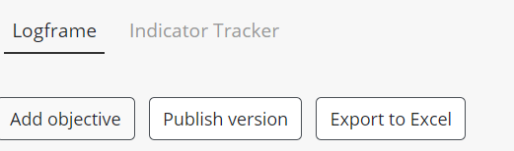
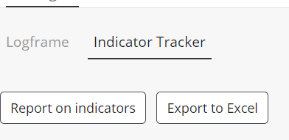


Publish logframe and access Indicator Tracker

Slide 25
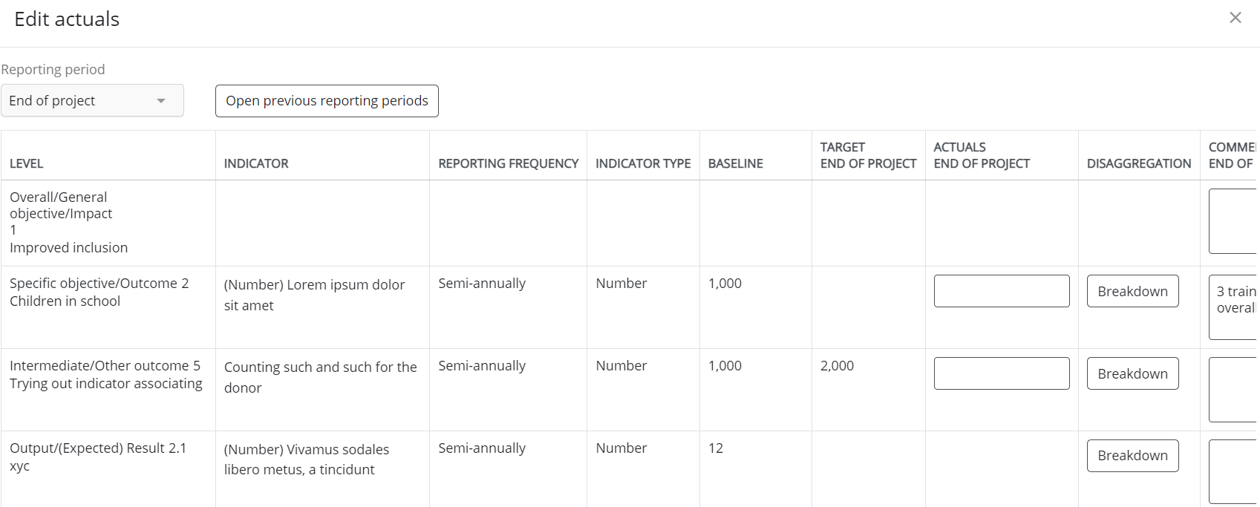
Report on Indicators
Click „Report on indicators“ and edit actuals
Send for review and/or approval.

